Slide 1
Knuckle Input
Simon Hagenmayer, Robin Schweigert, Jan Leusmann

Slide 2
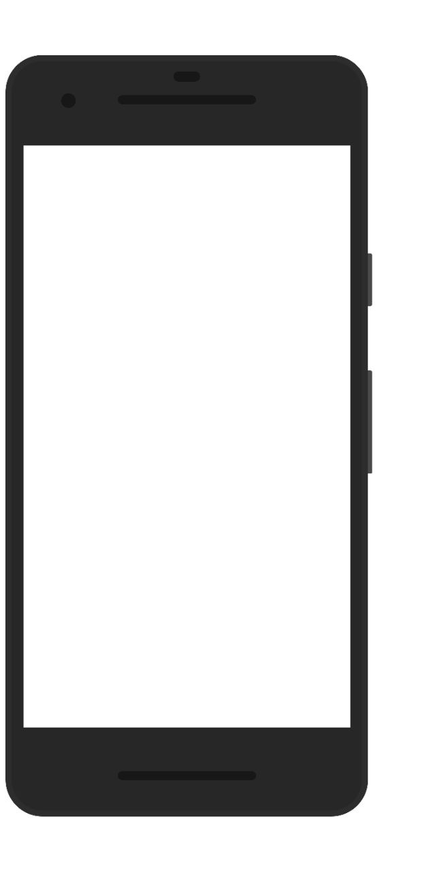
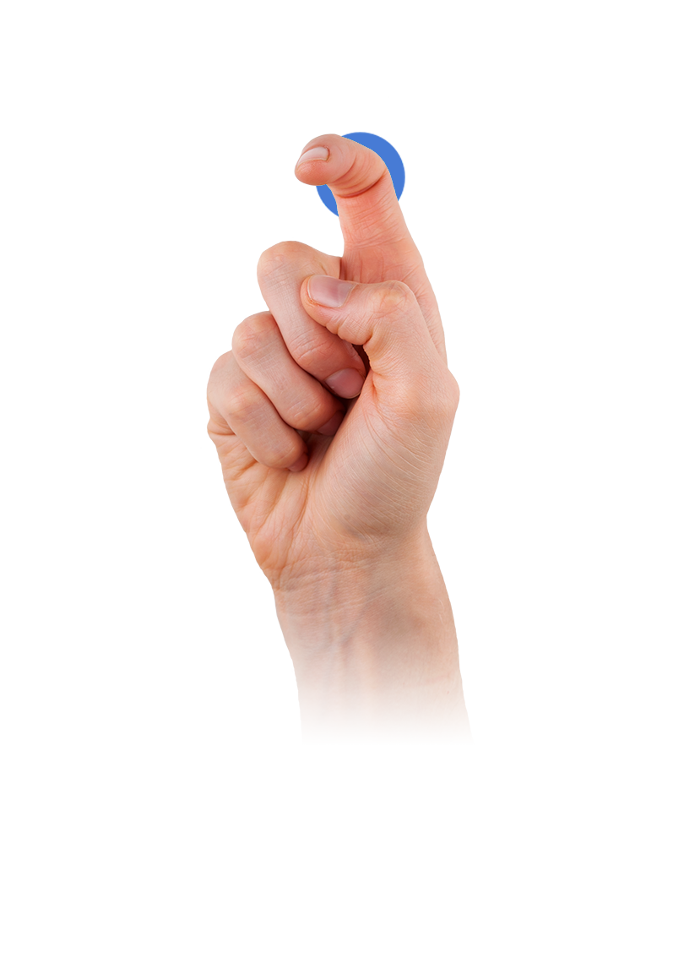
Motivation
Extend current options for input on a touchscreen
Recognize if touch input is finger or knuckle
Differentiate between 17 different gestures
source: qeexo.com/fingersense/

Slide 3
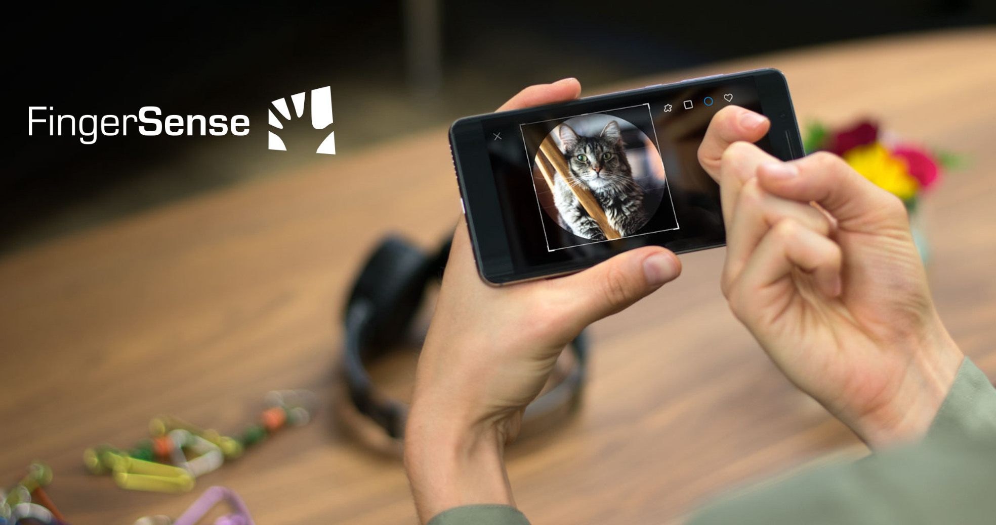
Related Work
TapSense
Sound-based
Differentiate between four different finger inputs
SVM: 86% accuracy
Nail+
3x3 grid of strain sensors, worn on the fingernail
Different levels of applied finger-force can be detected
85% accuracy
Qeexo FingerSense
Different inputs can be detected through their vibration on the touchscreen
Implemented in Huawei Smartphones
source: dl.acm.org/citation.cfm?doid=2935334.2935362
source: qeexo.com/fingersense/

Slide 4
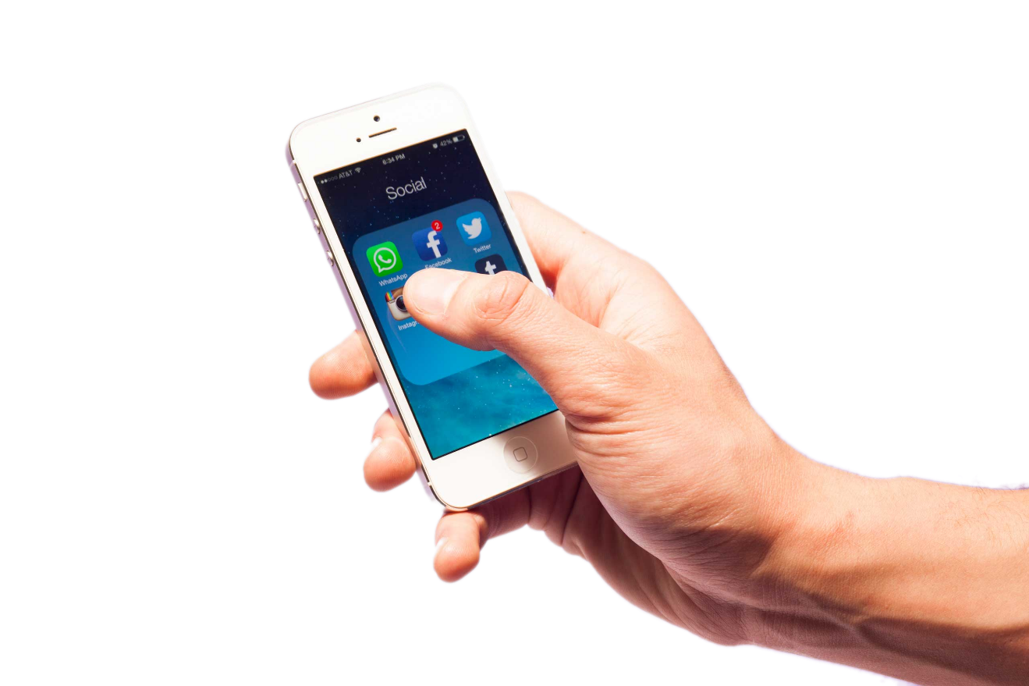
Study
Only right-handed, no movement impaired
Two-handed interaction only
17 Gestures
20 repetitions per gesture
Both knuckle and finger
Within-Subject design
17 participants
Study-length: 60 minutes
source: time.com

Slide 5
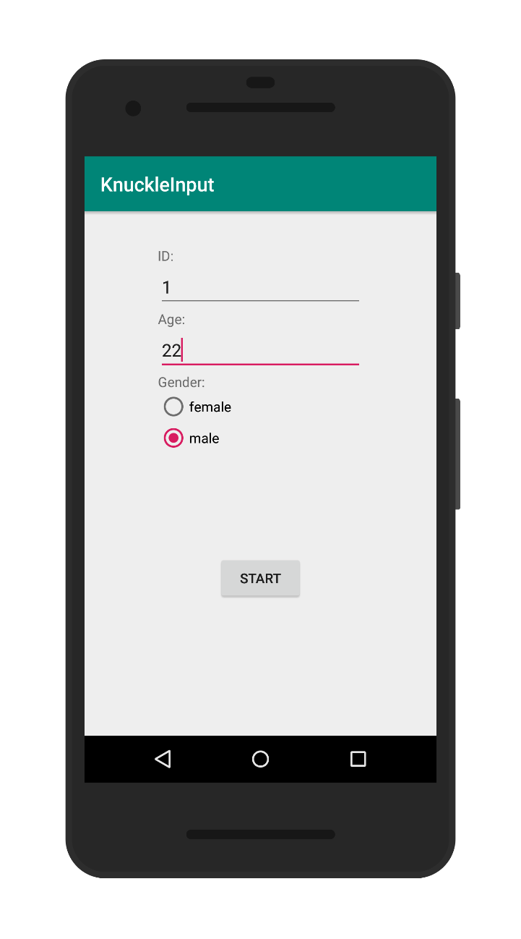
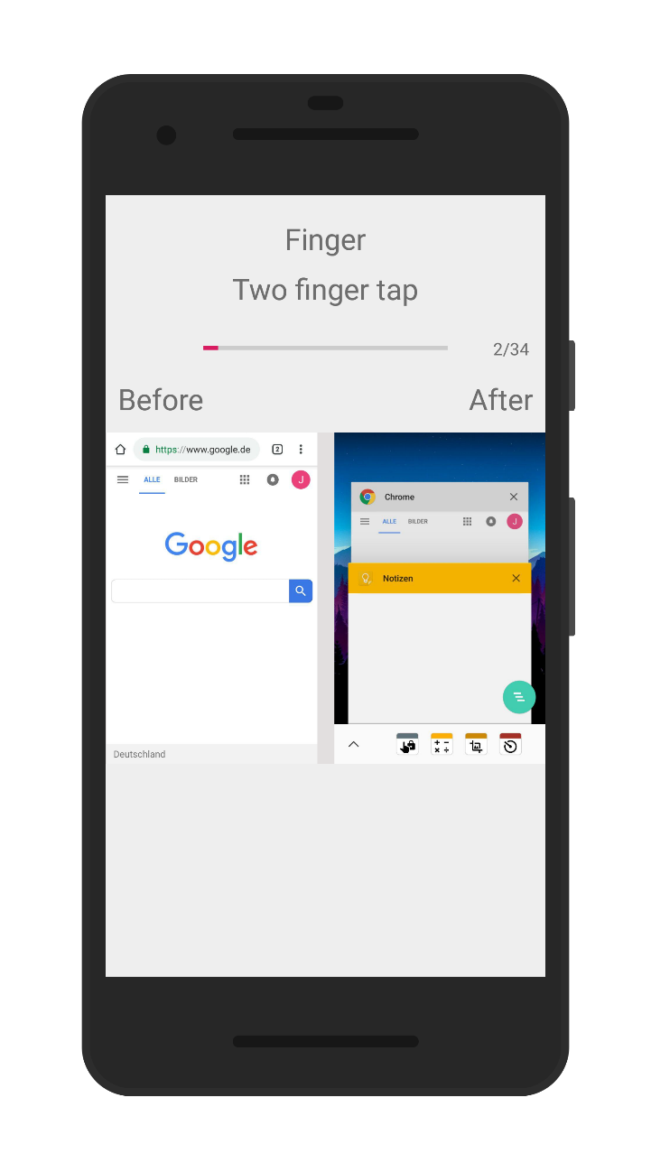
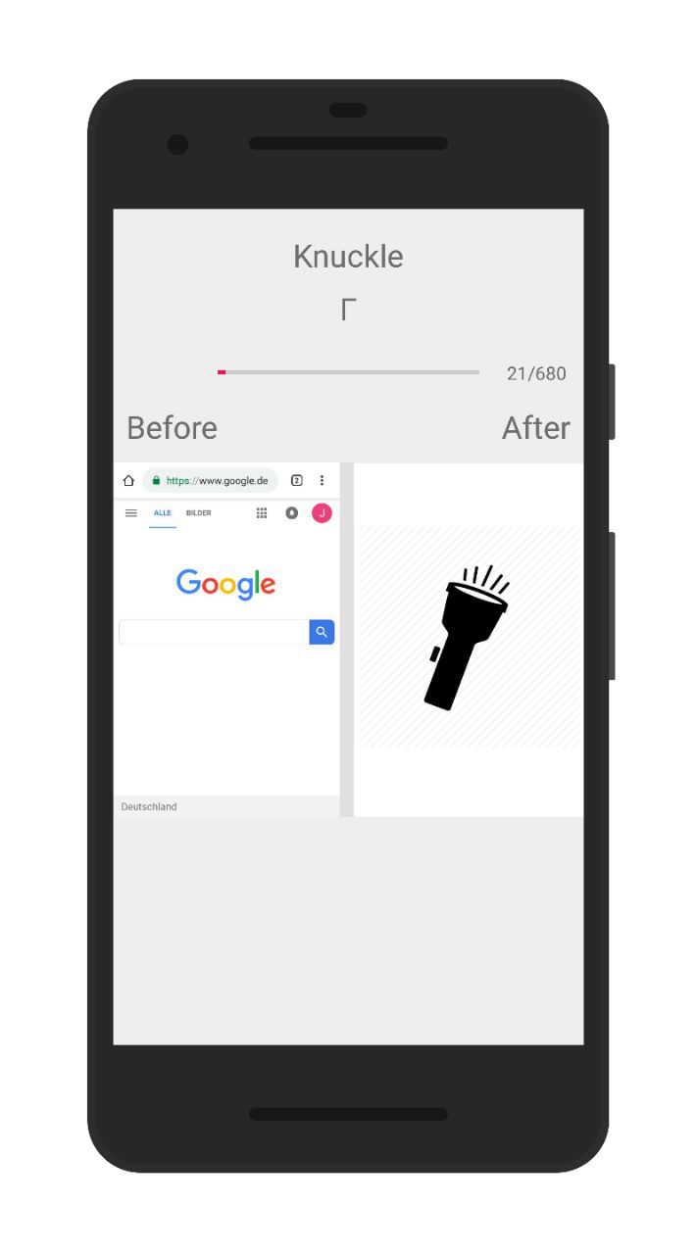
Study App

Slide 6
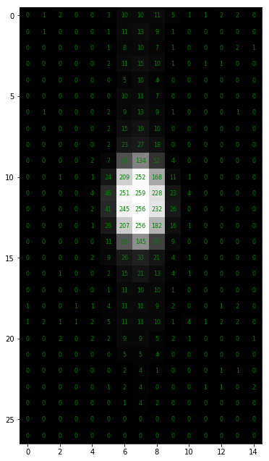
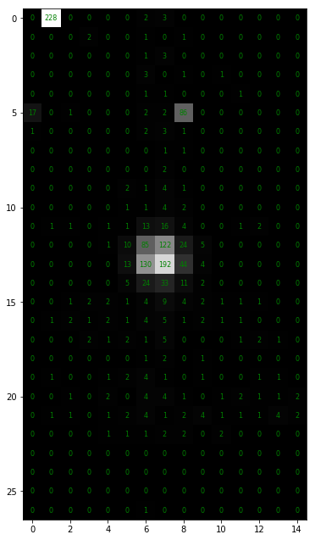
Data Collection: Data
956.426 images in total
27 x 15 pixels each
806.891 actual gesture images

Slide 7
Preprocessing: First Filters
Use highest repetition only
Blob detection on images
Get rid of images without blobs
Remaining: 155.439

Slide 8
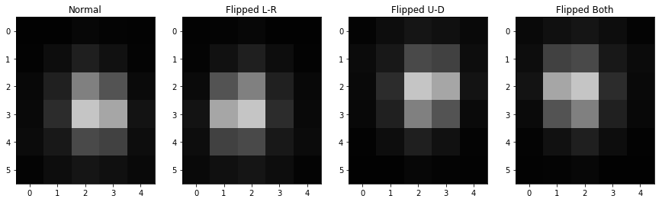
Preprocessing: Data Augmentation
Mirroring on both x and y-Axis
New total images: 621.756

Slide 9
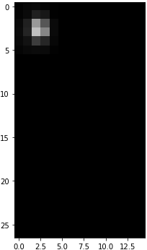
CNN: Structure
DENSE
DENSE
DENSE
Conv2D
Conv2D
BatchNorm
MaxPool2D
Dropout
Conv2D
Conv2D
BatchNorm
MaxPool2D
Dropout
Finger
Knuckle

Slide 10
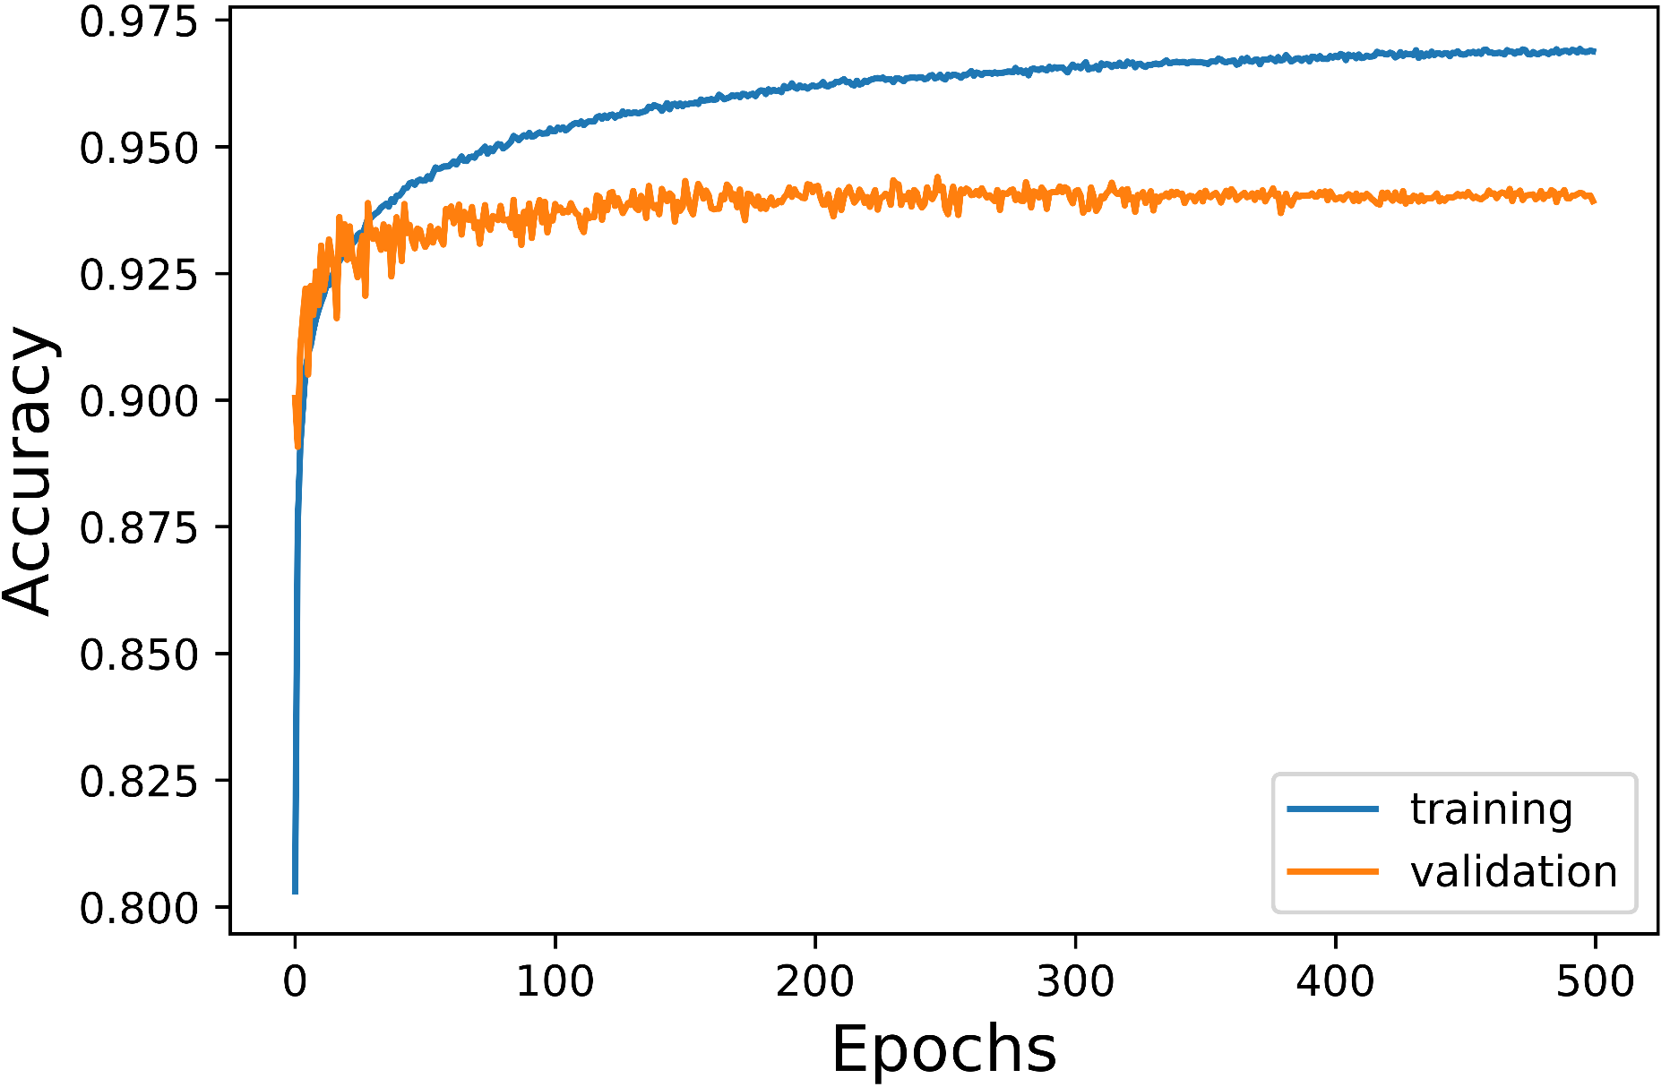
CNN: Results

Slide 11

CNN: Cross-Validation
TestID | ValAcc | Acc
1 | 0.9466 | 0.9596
2 | 0.9672 | 0.9577
3 | 0.9602 | 0.9533
4 | 0.9454 | 0.9612
5 | 0.9872 | 0.9571
6 | 0.9699 | 0.9562
7 | 0.9061 | 0.9625
8 | 0.9909 | 0.9560
9 | 0.8627 | 0.9613
10 | 0.8349 | 0.9636
11 | 0.8984 | 0.9586
12 | 0.9438 | 0.9596
13 | 0.9922 | 0.9589
14 | 0.9738 | 0.9568
15 | 0.9676 | 0.9569
16 | 0.9929 | 0.9543
17 | 0.9598 | 0.9545
Mean | 0.9470 | 0.9581
Leave one out
Trained for 500 epochs
Mean values are very similar to a general trained model

Slide 12
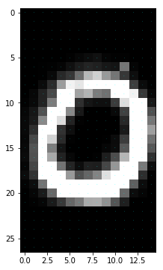
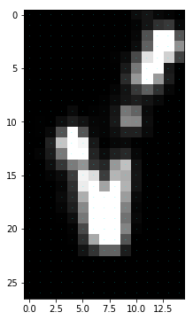
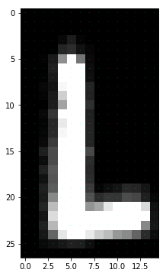
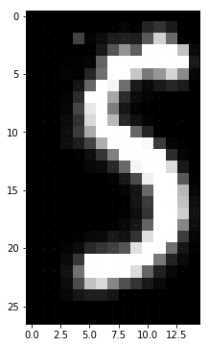
Gestures
First idea: CNN for gestures with combined images
Val. Accuracy ~ 40%
LSTM
Fixed window size (30/50)

Slide 13
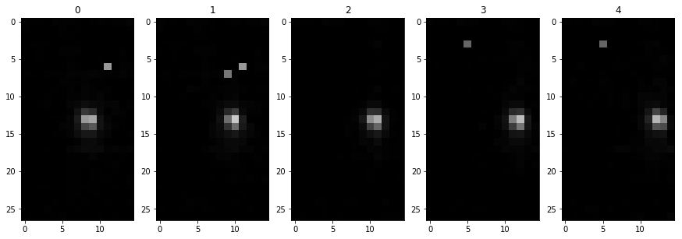
Preprocessing: LSTM
Take images between first and last blob
Reset gesture index
Remaining: 8.088 gestures

Slide 14
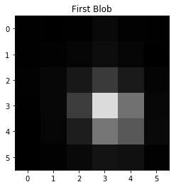
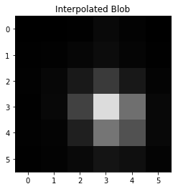

Preprocessing: Interpolation
Filter gestures by length
Fixed window size, some gestures are longer, some shorter → Interpolation
Detect blobs, interpolate blobs, interpolate positions

Slide 15
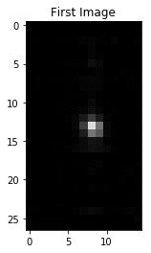
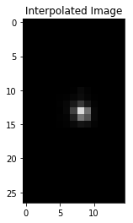
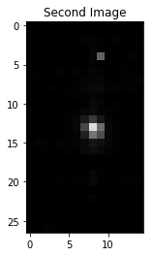
Preprocessing: Interpolation

Slide 16
LSTM: Structure
Tap
Two Tap
LSTM
DENSE
DENSE
Conv2D
Conv2D
MaxPool2D
Dropout
LSTM
Checkmark
Rotate

Slide 17
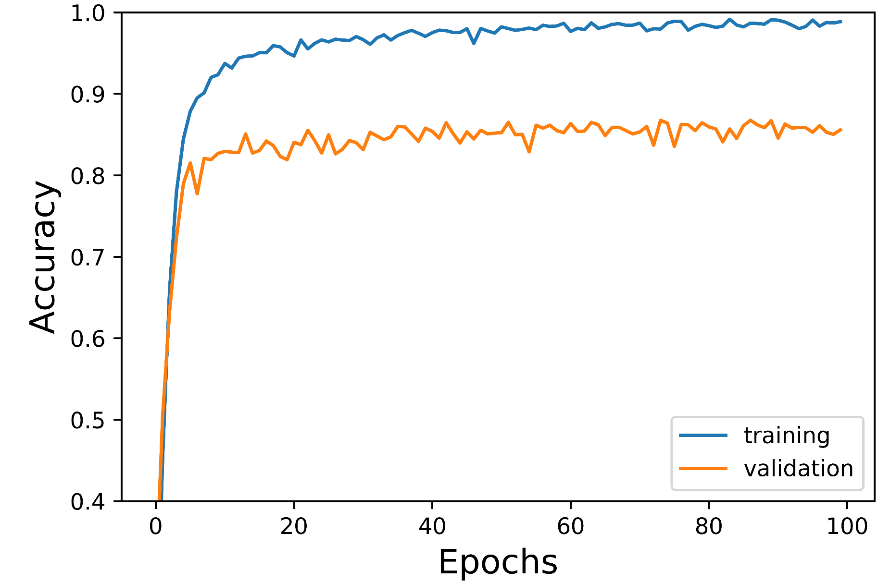
LSTM: Results

Slide 18
Combination
LSTM
Rotate | Rotate
CNN
FLATTEN
DENSE
Tap | Tap
Two Tap | Two Tap
Swipe Left | Swipe Left
CNN
CNN
Finger | Knuckle

Slide 19
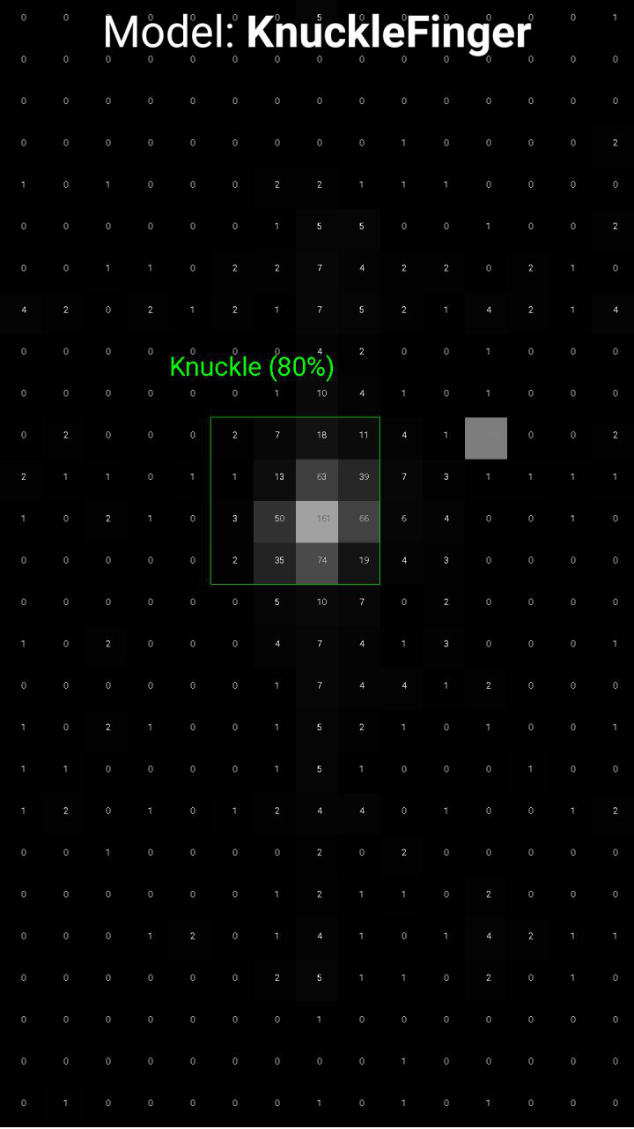
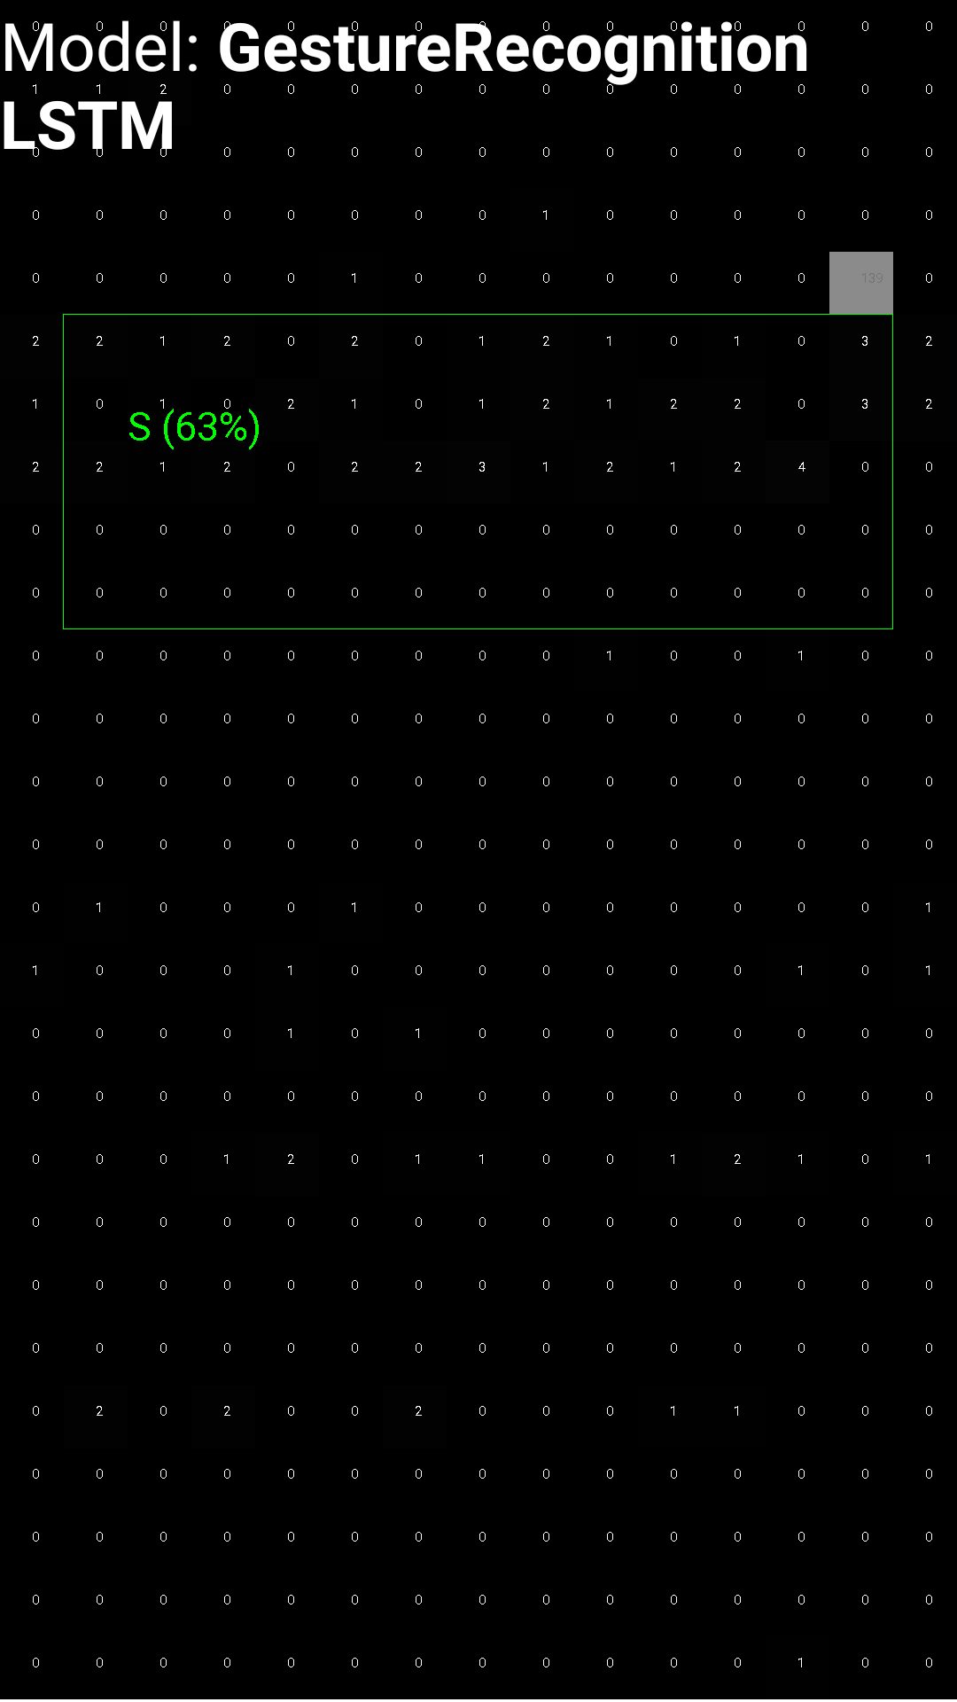
Demo App
CNN
LSTM
Visualisation:
Capacitive Image
Blob Bounding Box
Accuracy
Models used:
CNN (Knuckle/Finger)
LSTM (Gesture)

Slide 20
Future Work
Another data collection: Different touch angles
Combined gestures
Take away
Neural networks for capacitive images work great at detecting if a touchscreen input was done by a finger or knuckle (95% accuracy)
Gesture recognition with LSTMs for 17 different gestures also works fine (87% val. accuracy)

Slide 21
References
https://dl.acm.org/citation.cfm?id=2047279
https://dl.acm.org/citation.cfm?doid=2935334.2935362
https://qeexo.com/fingersense/

